Slide 1
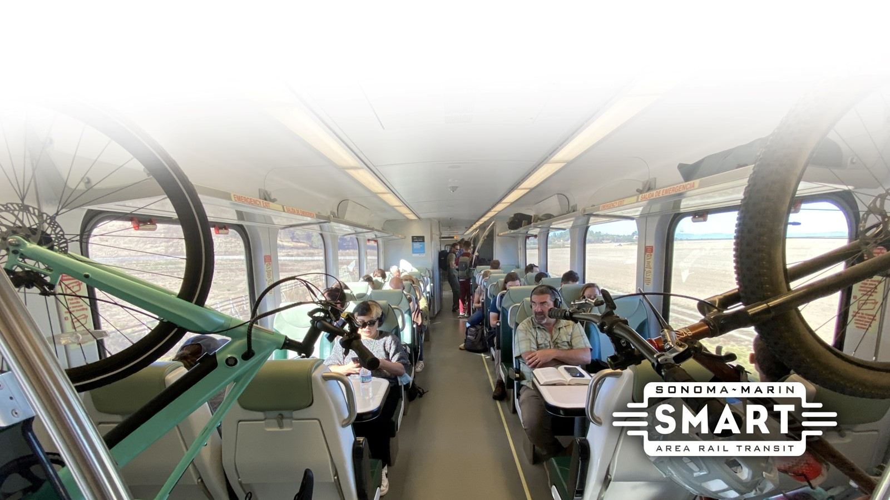
Agenda Item 9: Budget Amendment #9

Slide 2
Budget Amendment #9
Resolution No. 2024-40
  Modify Position Authority
  Increase Expenditure Authority

Slide 3
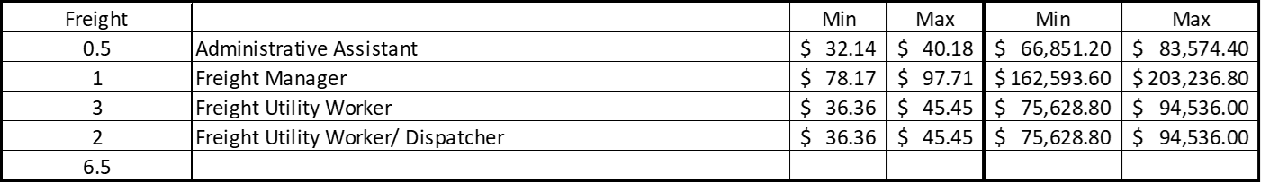
Position Authority
Need to shift freight dispatching services to Freight Employees
  Currently being done by Transportation Supervisors (approximately 2-4 hours/week)
Currently 4.5 Freight Utility Workers
  Only 3 of the 4.5 positions are currently filled and 1.5 positions vacant
  Add .5 position for a total of 5 Freight Utility Workers
Create 2 Freight Utility Worker/ Dispatcher positions
  Utilize 1.5 vacant positions + .5 new position

Slide 4
Increase Expenditure Authority
Funding for additional .5 FTE
  January 2025 – June 2025
  $38,787.50
Funding for .5 FTE that was authorized but not budget due to funding
  January 2025 – June 2025
  $38,787.50
Total funding required for January 2025 – June 2025 = $77,575
Premium pay of 15% will be paid only when positions are dispatching

Slide 5
Increase Expenditure Authority
Need $77,575
  $15,791 will come from service and supplies
  $61,784 will come from fund balance
Fund Balance
  This budget action will reduce fund balance to $0
  Still have $4 million that will be available from state grant coming sometime Spring 2025 that is not budgeted

Slide 7
Questions?

Slide 8
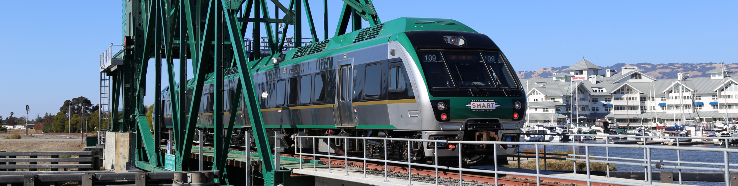

www.sonomamarintrain.org
Customer Service:
CustomerService@sonomamarintrain.org
(707) 794-3330
8

